Slide 1
Black History Month
African Americans and the Arts

Slide 2
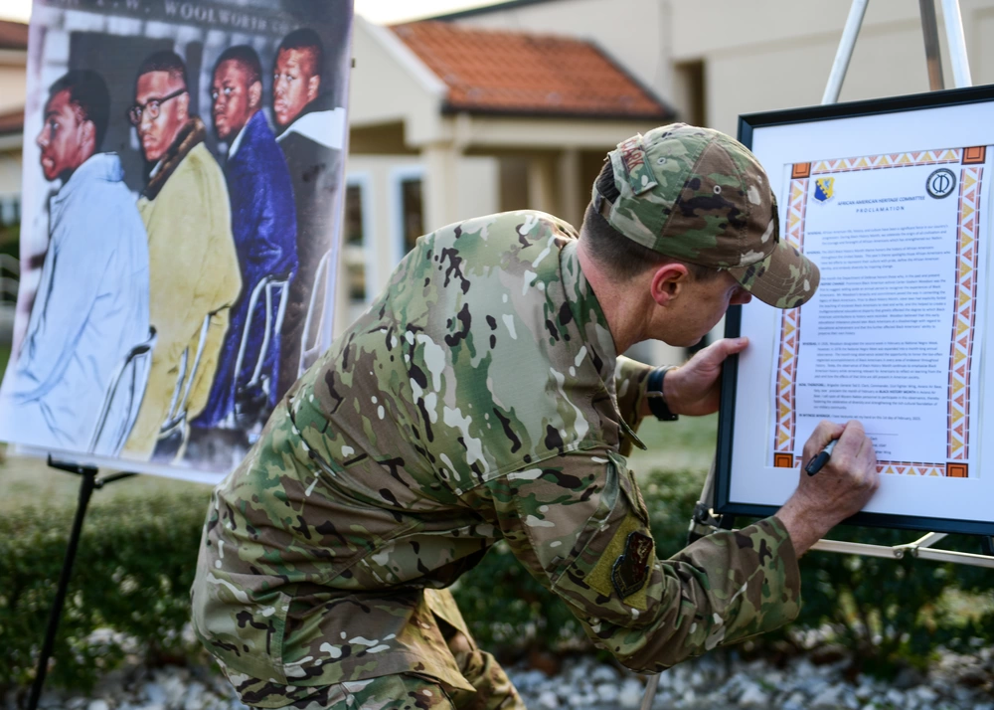
Black History Month 2024
Black History Month is an annual observance originating in the United States, where it is also known as African-American History Month.
Each year the Department of Defense (DoD), along with the rest of the Nation, recognizes the important contributions and rich culture of African Americans.

Slide 3
Theme
The Association for the Study of African American Life and History (ASALH) has chosen for the 2024 theme, “African Americans and the Arts.”
The ASALH press release states the theme “…showcases the artistic contributions by African Americans throughout history in the fields of visual and performing arts, literature, fashion, folklore, language, film, music, architecture, culinary and other forms of cultural expression.”
This presentation focuses on veterans and artists Lt. James R. Europe, Leonora Hull Brown, and Horace Pippin.

Slide 4
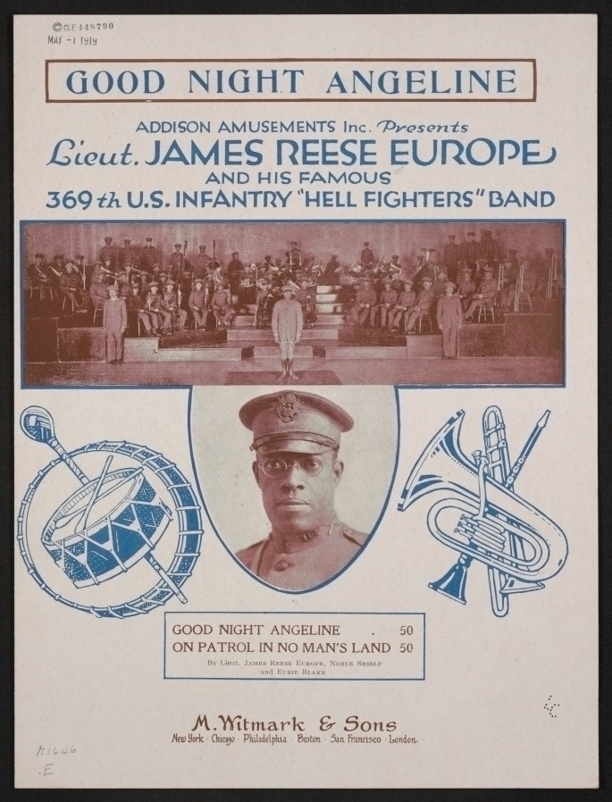
Lt. James R. Europe (1 of 3)
Lt. James R. Europe brought African American music genres international while leading the 369th Infantry Regiment “Hell Fighters” band.
Born in Mobile, Alabama, in 1881, Europe became one of America’s greatest musical innovators. After moving to New York City in 1910, he formed two organizations that conducted orchestras and choruses as well as served as a union and contracting agency for hundreds of Black musicians.

Slide 5
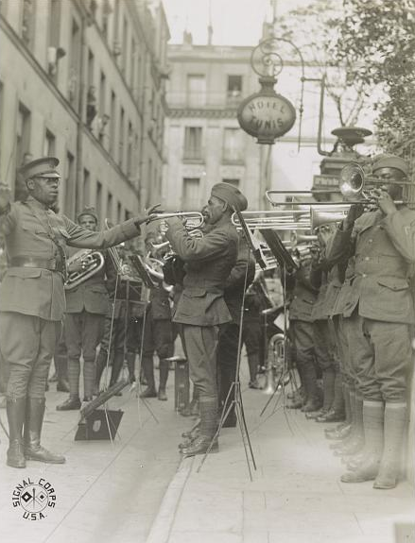
Lt. James R. Europe (2 of 3)
After the United States entered World War I, Europe was commissioned as a lieutenant where he led the regimental Army band.
His Black musicians proudly played their own original music, including jazz, blues, ragtime, and patriotic tunes, amazing European audiences who were unable to replicate their unique sound. Lt. Europe and his band were celebrated as heroes upon their return at the war’s end.

Slide 6
Lt. James R. Europe (3 of 3)
Europe was one of the first mainstream African American musicians. He is recognized as a composer, arranger, and American band leader and is credited as a major figure in transitioning ragtime into jazz and popularizing social dancing across the social class spectrum.
Tragically, having survived the trials of World War, he was stabbed during a confrontation with one of his own bandsmen and he died in 1919. Europe was granted the first ever public funeral for a Black American in New York City.

Slide 7
Leonora Hull Brown (1 of 3)
Leonora Hull Brown, a Women’s Army Corps member during World War II, was crucial in creating the military’s only all-Black female band.
Brown helped form the group after being denied participation in the all-White band. As the only one with musical experience, and with just 8 weeks until their first performance, Brown taught the women volunteers how to play instruments. Their first performance far exceeded expectations.
This group became recognized as the 404th Armed Service Forces band as it fought an uphill battle against discrimination and sexism.
Notes:
Source:
https://www.smithsonianmag.com/history/seventy-five-years-ago-militarys-only-all-black-female-band-won-victory-against-war-department-180971815/

Slide 8
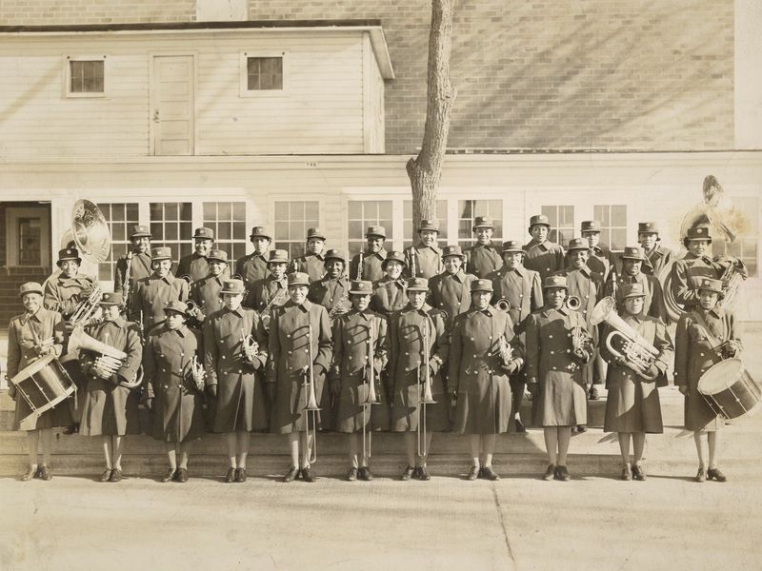
Leonora Hull Brown (2 of 3)
After several performances, they were defunded by the Army. However, through community activism, they were reinstated.
“Our officers urged us to fight for our existence,” Brown said, “and told us that this could best be done by asking our friends and relatives to write letters of protest to powerful persons.”

Slide 9
Leonora Hull Brown (3 of 3)
An outpouring of support from the Black community and leaders forced the Army to reverse its decision a month later.
Brown reorganized the band and it was recruited to support the Seventh War Bond Drive’s opening day parade in Chicago in May 1945. Only expected to participate for one day, the positive reception inspired organizers to request the Army to extend the visit. The group then toured the local black communities, schools, and neighborhoods.
Collectively, the Seventh War Bond Drive helped raise $26 billion over 6-weeks. Several weeks later the war ended. In December 1945, the only Black female band was deactivated.
Notes:
Source:
https://www.smithsonianmag.com/history/seventy-five-years-ago-militarys-only-all-black-female-band-won-victory-against-war-department-180971815/

Slide 10
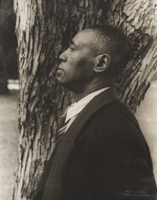
Horace Pippin (1 of 3)
Horace Pippin is one of the most celebrated African American painters of the 20th century and a veteran of World War I. Being self-taught, Pippin used a linear art style with powerful design and expressive color.
His work covers subjects like African American genre scenes, portraits, biblical scenes, and political paintings, such as John Brown Going to His Hanging and Prejudice.

Slide 11
Horace Pippin (2 of 3)
From West Chester, Pennsylvania, Pippin enlisted in what would become the Army’s 369th Infantry Regiment. During his service, a sniper shot permanently disabled his right arm.
Pippin wrote a vivid account of his wartime service and experiences in a 61-page journal which contains numerous battlefield illustrations detailing his injury and which inspired his later work.
Returning home as a disabled veteran, he faced both racism and ableism and encountered social and employment barriers. Working against these oppressive structures, Pippin produced wood-burnt panels as a form of therapy.
Notes:
https://www.nga.gov/collection/artist-info.25.html

Slide 12
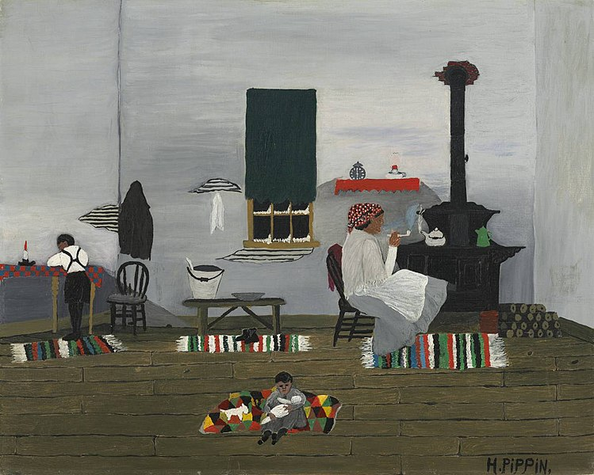
Horace Pippin (3 of 3)
Unable to return to manual labor, Pippin began making oil paintings. A major force in the folk-art revival of the 1930s, he developed a unique technique and style. His exposure and popularity grew as he distilled his experiences and memories into images of great power and poignancy.
Pippin is an African American artist who overcame a war injury to earn national acclaim for his paintings.
Notes:
https://www.metmuseum.org/perspectives/articles/2023/7/considering-horace-pippin
https://philamuseum.org/calendar/exhibition/horace-pippin-war-peace

Slide 13
Conclusion
The stories of incredible artists like Lt. James R. Europe, Leonora Hull Brown, and Horace Pippin exhibit just a few of the countless contributions to the arts made by African Americans. Their complex, trailblazing work has impacted the hearts and minds of millions of people. Black History Month is a time of year to celebrate and honor all Black Americans, whether they are in the military, in the arts, both, or neither.
During this special observance, the DoD honors the contributions made by African Americans in the arts and celebrates diversity, inclusion, and accessibility for all Americans.

Slide 14
Prepared by the Defense Equal Opportunity Management Institute, Patrick Space Force Base, Florida
February 2024
All photographs are public domain and are from various sources as cited.
The educational information within this presentation is designed to raise individuals’ general awareness on this topic. The information in this document is not to be construed as an official DEOMI, U.S. Military Services, or Department of Defense position.

